Slide 1

Group 34
Part IV Project
Real-time Pacemaker for Gastrointestinal Diseases
Glacer Barnett
gbar999
Yogesh Dangwal
ydan124

Slide 2
1
What is gastroparesis?
2
Treatment: The Gut Pacemaker
3
MATLAB Model: Limitations and Challenges
4
The Solution: Embedded Processor
5
Results
6
Conclusion and Future Work
TABLE OF CONTENTS

Slide 3
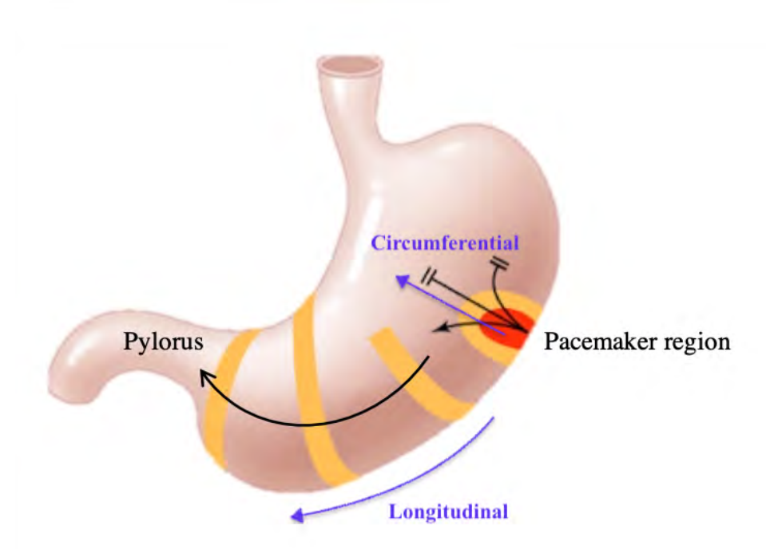
What is gastroparesis?
chronic motility disorder characterized by delayed emptying of meals
gastric motility is important for nutrition
ICC cells produces Slow waves

Slide 4


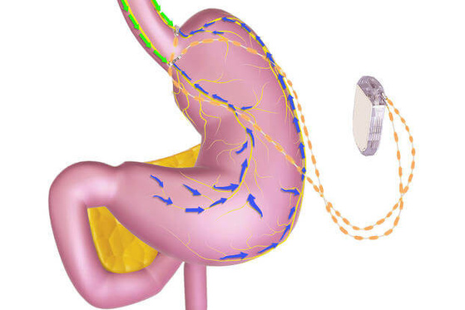
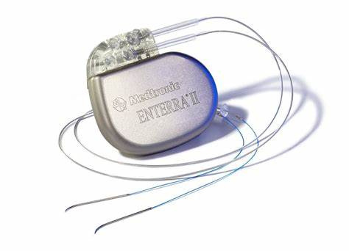
TREATMENT
Implantable open-loop devices: risk of over pacing
OPEN LOOP
Gastric Pacemakers
CLOSED LOOP

Slide 5
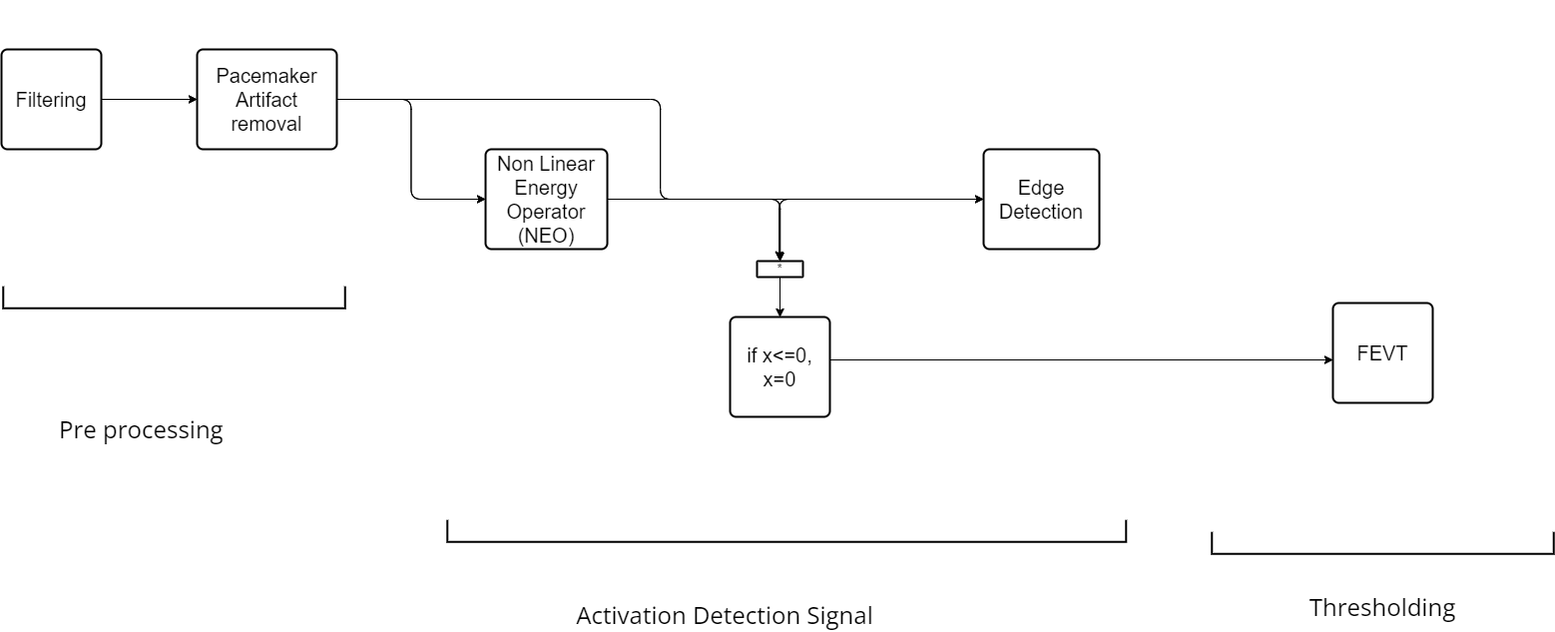
MATLAB MODEL FOR DETECTION

Slide 6
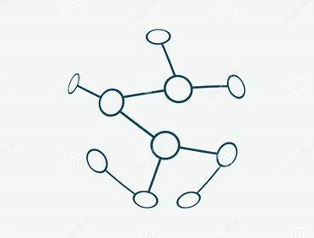

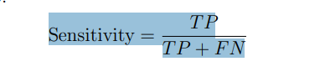
Model of Efficiency and
Area Of Improvement
Efficiency
for
Input Type
HIGH-RESOLUTION INPUT
96%
LOW-RESOLUTION INPUT
63.4%
Back to Agenda

Slide 7
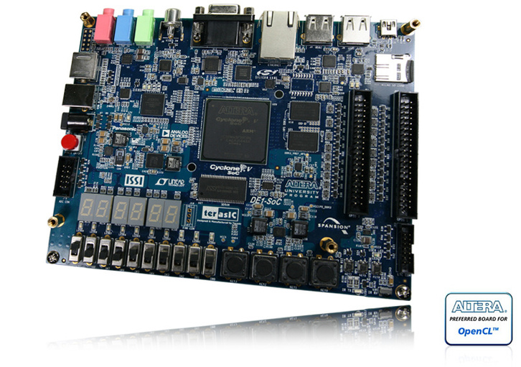
EMBEDDED
PROCESSOR
01
C/C++ and Desoc
02
YOCT0 - Basic Linux
03
ARM Processing

Slide 8
Achieve real-time execution of the gut pacemaker
Embedded Processor: Advantages
Compatible hardware Integration
Resource Efficiency
MATLAB -> C
for real-time application
Real-Time Optimization
Improved Performance

Slide 9
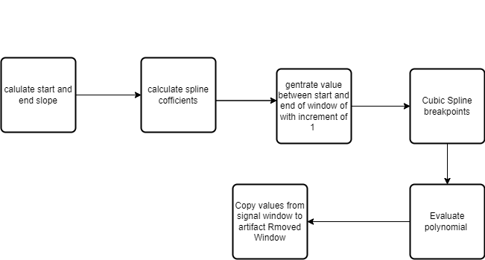
ALGORITHM IMPLEMENTATION
Notes:
FOR FILTERING WE IMPLENTED BUTTERWORTH STYLE FILTER. dOESN'T WORK A EXPECTED WE HAVE HARDED CODED INPUT .
oNE OF THE MOST TOUGH PART IN cc IMPLEMENTTAION WAS ARTICFACT REMOVING WE USE CALUCLUAT START AND AND END SLOPE AND USE THESE FOR CALULATING COFITIENTS OF SPLINE tHEN WE DID A CUPIC SPLINE AND A PIECE . THEN WE DEFINE BRA=EAK POINT FOR CUBIC SPLINE AND THEN EVALUATE THE PICEWISE FUNCTIONS ON THOSE POINTS AND SUBSTITUE IT WITH ARTIFICIAL ARTIFACT.
FOR ARTIFACT DETECT we used math library

Slide 10
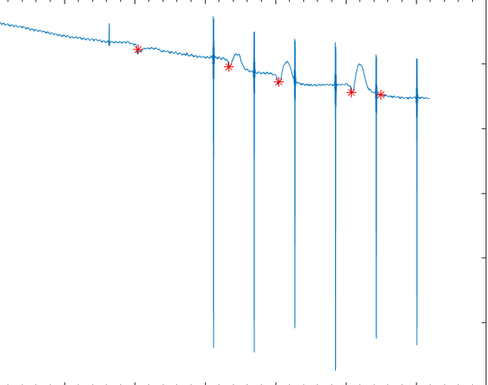
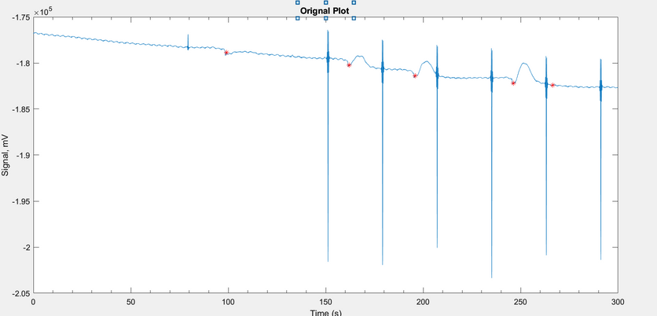
RESULTS
NEW
PREVIOUS
84.5% HIT RATE
84.46% HIT RATE
Experiment Data | True Positives | False Negatives | False Positives
exp16 | 438 | 80 | 245

Slide 11




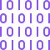
FUTURE WORK: MACHINE LEARNING
Implementing machine learning algorithms using the sliding window aproach to improve binary classification of pacing.
Algorithms such as SVM are considered as time-series data is extracted
TIME SERIES
SEQUENTIAL ANALYSIS
FEATURE EXTRACTION
BINARY CLASSIFICATION

Slide 12
Conclusion
Research project on gut pacemaker model shows promising progress.
Converted model to C programming language for real-time execution.
Machine learning algorithms such as SVM are considered for optimized binary classification of pacing.
Future work aims to achieve even better results and further advancements and come up with a histogram of worst-case execution times (WCET) to check real-time performance

Slide 13
Thank You
End of The Page

